Slide 1


AR UI | Ray Interaction

Slide 2
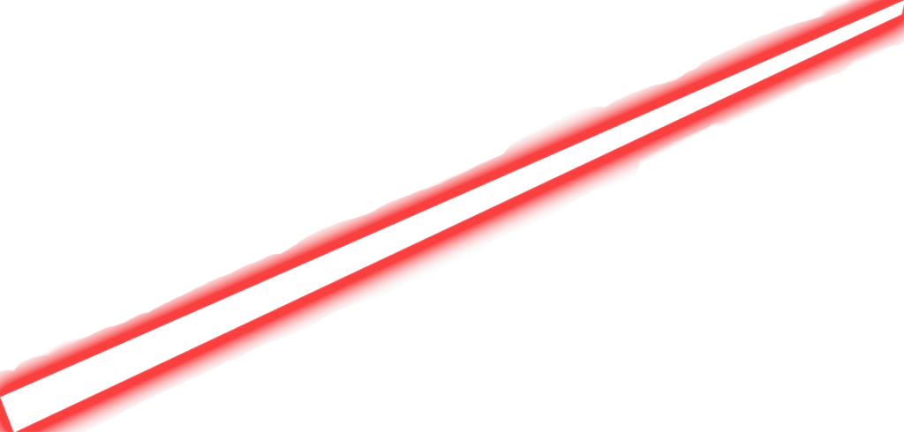
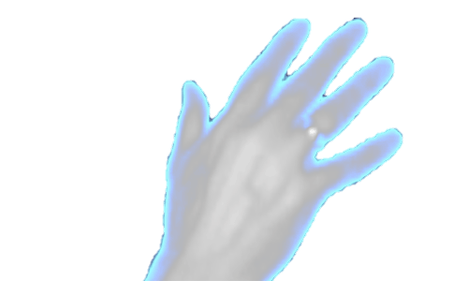
AR UI | Ray Interaction

Slide 3
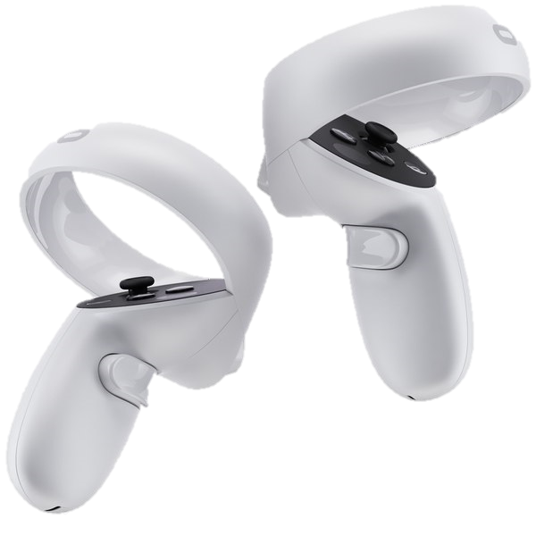
AR UI | Controller Pose

Slide 4


Transformer
Introduction

Slide 5


Slide 6


